Slide 1
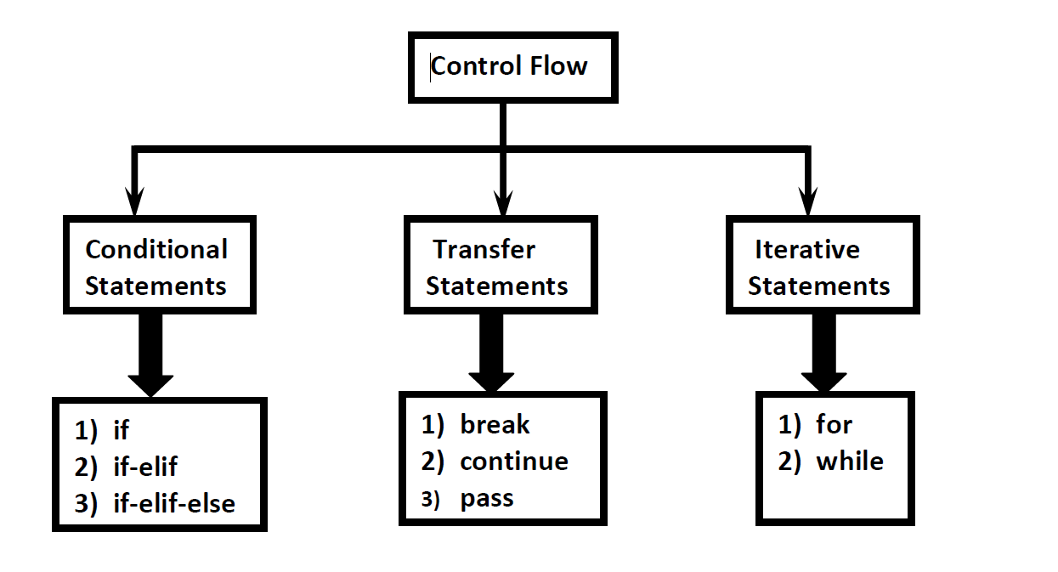
FLOW CONTROL
To control the flow of execution

Slide 2
if statement:
It works based on condition. If the condition is True then enters into code inside the block.
Syntax:
if condition:
statement 1
statement 2
.
statement n
Example:
a=10
b=4
if a>b:
print(“a is greater than b”)

Slide 3
Indentation:
Indentation refers to the spaces at the beginning of a code line. Where in other programming languages the indentation in code is for readability only, the indentation in Python is very important.
Python uses indentation to indicate a block of code.
4 spaces or 1 tab
a=4
b=2
if a>b:
print(a)
IndentationError: expected an indented block

Slide 4
if-else:
If there are two code blocks to be executed.
syntax:
if condition:
statement 1
statement 2
else:
default statement
name=“Python”
if name==“Python”:
print(“the correct name is entered:”)
else:
print(“the name is incorrect”)

Slide 5
if-elif-else
If there are more than two statements to be executed.
multiple elifs can be used
syntax:
if condition 1:
statement 1
elif condition 2:
statement 2
else:
statement 3.

Slide 6
else part is always optional. Hence the following are various possible syntaxes. 1) If
2) if – else
3) if-elif-else
4) if-elif
There is no switch statement in Python

Slide 7
Range():
range Data Type represents a sequence of numbers.
The elements present in range Data type are not modifiable. i.e range Data type is immutable.
It omits the last value.(i.e sequence ends at stop-1)
Syntax:
range(start ,stop, step)
Ex:
range(1,10)

Slide 8
Ternary Operator (Conditional Operator)
It is optimized code for if else conditions.
If condition is True then first Value will be considered else second Value will be considered.
Syntax:
name= firstValue if condition else secondValue
Normal if else
A=100
B=250
if A>B:
print(A)
else:
print(B)
Ternary operator:
A=100
B=250
C=A if A>B else B
print( C)

Slide 9
Iterative Statements
If we want to execute a group of statements multiple times then we should go for Iterative statements.
Python supports 2 types of iterative statements.
1) for loop
2) while loop

Slide 10
for loop:
If we want to execute some action for every element present in some sequence (it may be string or collection) then we should go for for loop.
Syntax:
for x in sequence:
Statements
Where sequence can be string or any collection.
Body will be executed for every element present in the sequence
Ex: name =“Python”
for i in name:
print(i)

Slide 11
While loop
If we want to execute a group of statements iteratively until some condition false, then we should go for while loop.
Syntax:
while condition :
statements
i=0;
while True :
i=i+1;
print("Hello",i)

Slide 12
Transfer Statements
break:
We can use break statement inside loops to break loop execution based on some condition.
Ex:
cart=[100,200,6000,600,700]
for item in cart:
if item>5000:
print(“It is higher value")
break
print(item)

Slide 13
continue:
We can use continue statement to skip current iteration and continue next iteration
EX:
for i in range(10):
if i%2==0:
continue
print(i)

Slide 14
pass
pass is a keyword in Python.
In our programming syntactically if block is required which won't do anything then we can define that empty block with pass keyword.
It is an empty statement
It is null statement
It won't do anything

